Slide 1

Session 10
Dictionary

Slide 2
Dictionary in Python

Slide 3
What is a “Dictionary”?
Like a dictionary in real life which has words and meanings, dictionary in Python contains pairs of keys and values
Each key has a value, key can’t be duplicate
Access the value through the key
car = {
"brand": "Toyota",
"year": 2010,
"price": 400.45,
"colors": ["grey", "red", "blue"]
}

Slide 4

Access, add and update a key-value pair
Access the value in the dictionary with dict[key]
To add a new key-value pair, use the syntax dict[key] = value
If the key-value is already exist, update the value with the syntax dict[key] = new_value

Slide 5
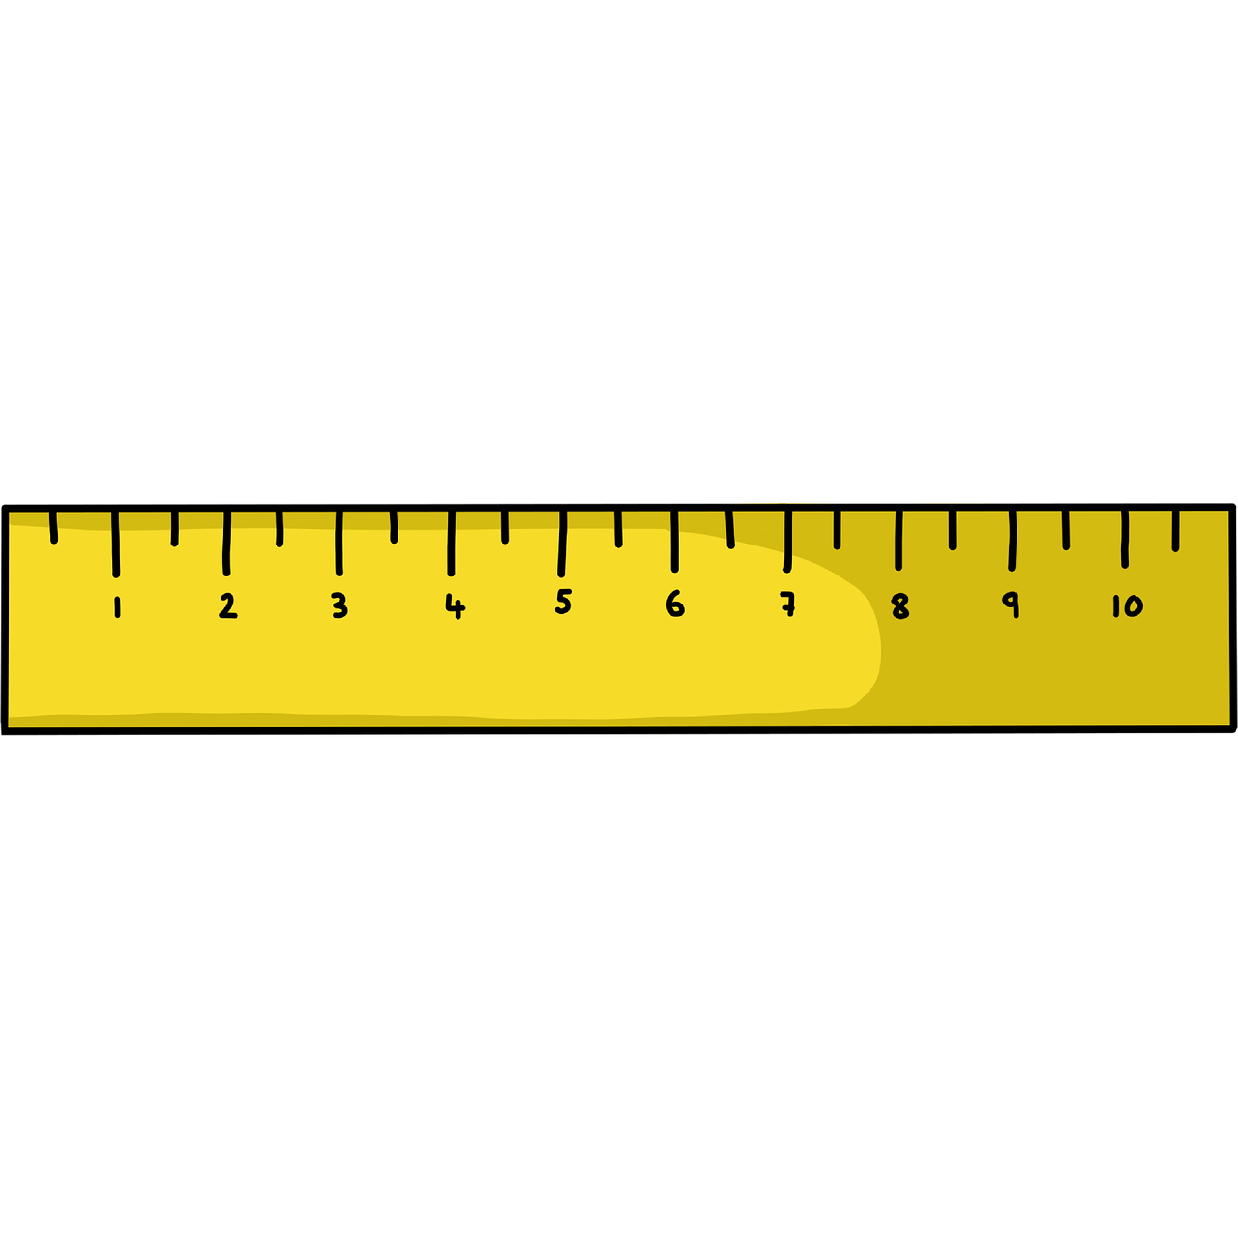




Common dictionary operations
del dict[key]
dict.pop(key)
len(dict)
dict.clear()
key in dict
dict.copy()
Get the items size
Clear the whole dictionary
Delete a key-value pair
Check if key exists
Copy a dictionary

Slide 6
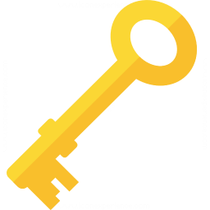

Iterate through the dictionary
for key in dict:
for key in dict:
dict[key]
for value in dict.values():
For (key, value) in dict.items():
Loop through all the keys
Loop through all the values
Check if item exists in a list

Slide 7
Some note about mutability vs immutability
The value can be of any type: int, string, list, set,... Even another dictionary
In order to keep the key unique, Python has to hash it, therefore only immutable data type can be used as key

Slide 8
THANKS!
See you in the next lesson!
Please keep this slide for attribution.

